Slide 1

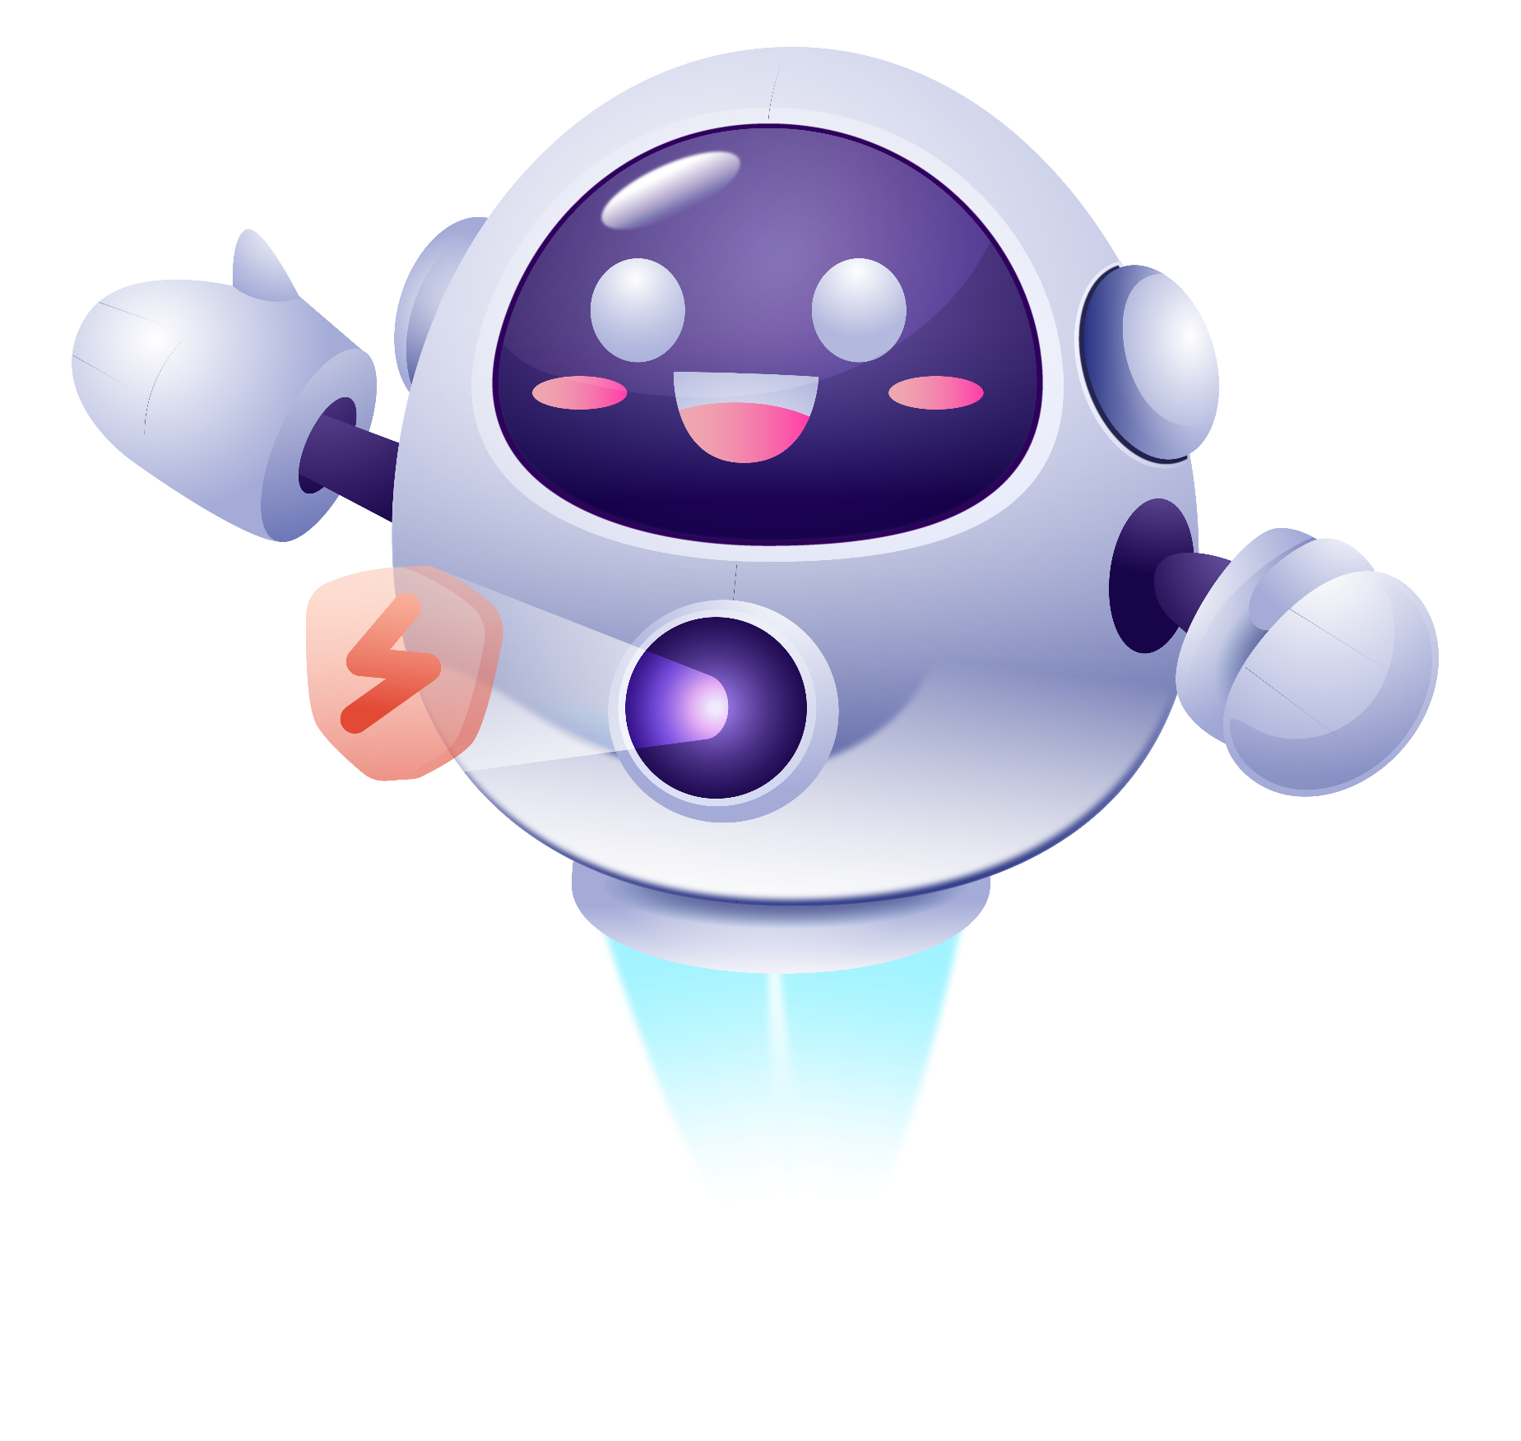


MACHINE LEARNING IN AGENTIC AI
Generative AI & Agentic AI
From Generating Content to Taking Action
Group - DevAstra
Generate → Reason → Act

Slide 2
What is Generative AI?
.
Generative AI creates new content by using patterns learned from large datasets and responding to user prompts.
01
02
03
Prompt
Foundation Model
Natural language instruction
Learned multi-modal weights
Generated Output
PRODUCTION EXAMPLES
Text, code, audio, or video
ChatGPT · Gemini · Claude · Copilot

Slide 3
How Generative AI Works
.
From raw human prompts to probabilistic next-token generation and domain grounding.
01
User
Prompt
Foundation Model
Generation
Output
02
03
04
05
Issues objective
Tokenized input
Transformer layers
Inference & decoding
Resolved response
GENERATION FLOW
User → Prompt → Tokenization → LLM → Next-Token Prediction → Output

Slide 4
From Generating to Acting
GenAi to Agentic Ai
GENERATIVE AI - “Tell me how to do it.”
Generates an answer, code, or content.
AGENTIC AI - “Do it for me.”
Understands → Plans → Acts → Checks → Adapts
Software example: GenAI writes a login API; an AI agent understands, plans, codes, tests, debugs, and repeats. (Answering questions → Completing tasks)

Slide 5

What is Agentic AI?
Agentic AI pursues a goal through reasoning, planning, tool use, observation, and iterative actions.
Goal → Plan
Act
Defines the objective and decides the steps to achieve it.
Uses tools or APIs to perform the planned action.
Observe
Evaluate → Act again
Checks the result and gathers new information.
Act Again: Evaluates the result and adjusts the next action if needed.
Reasoning, Planning, Tools, Memory, Observation, Feedback

Slide 6
Anatomy of an AI Agent
Goal → AI model / reasoning → Tools, Memory, RAG → Action → Observe → repeat
The model is the brain; tools give the agent the ability to act.
Tools → APIs
Memory → Context
RAG → Knowledge

Slide 7
AI Harness — The Environment Around the Agent
A harness provides the runtime environment, controls, and infrastructure that help an AI agent operate reliably.
AI MODEL → AGENT → HARNESS → TOOLS • MEMORY • APIS • EXECUTION
THE HARNESS SUPPORTS AND CONTROLS THE AGENT
Tool execution
Permissions & security
State & memory
Monitoring & logging
Agent loops
Validation & guardrails, Human approval
Model = brain
Agent = decision maker
Harness = operating environment and control system.

Slide 8
From AI That Generates → AI That Executes
GENERATIVE AI
Creates content · Prompt → Response · Mostly reactive · Generates code
AGENTIC AI
Achieves goals · Goal → Action → Result · Can operate autonomously · Can build, test, and execute tasks
Foundation Model → Agent + Reasoning → Tools + RAG + Memory → Harness + Guardrails → AI System
Generative AI gives AI the ability to create. Agentic AI gives it the ability to act.

Slide 9
Thanks!

